Slide 1
Welcome to
AI with Deep learning
Chris Watkins | Zongyuan Ge | Gin Tan

Slide 2
Overview
10 a.m. - 12 p.m. - Chris will first introduce the principles of deep learning models and concepts including neural network and convolutional neural network (CNN).
12 p.m. - 12:45 p.m. - Lunch break
12: 45 p.m. - 2:30 p.m. - Then Zongyuan will cover a case study about how to modify and implement a deep learning based calibration module to fit the research aim.
2:30 p.m. - 4 p.m. - Lastly, we will go through a few best practices on how to use the high-performance computing (HPC) cluster to request GPUs and accelerate the training speed of the deep learning model

Slide 3
Intro to Deep Learning
Christopher Watkins

Slide 4
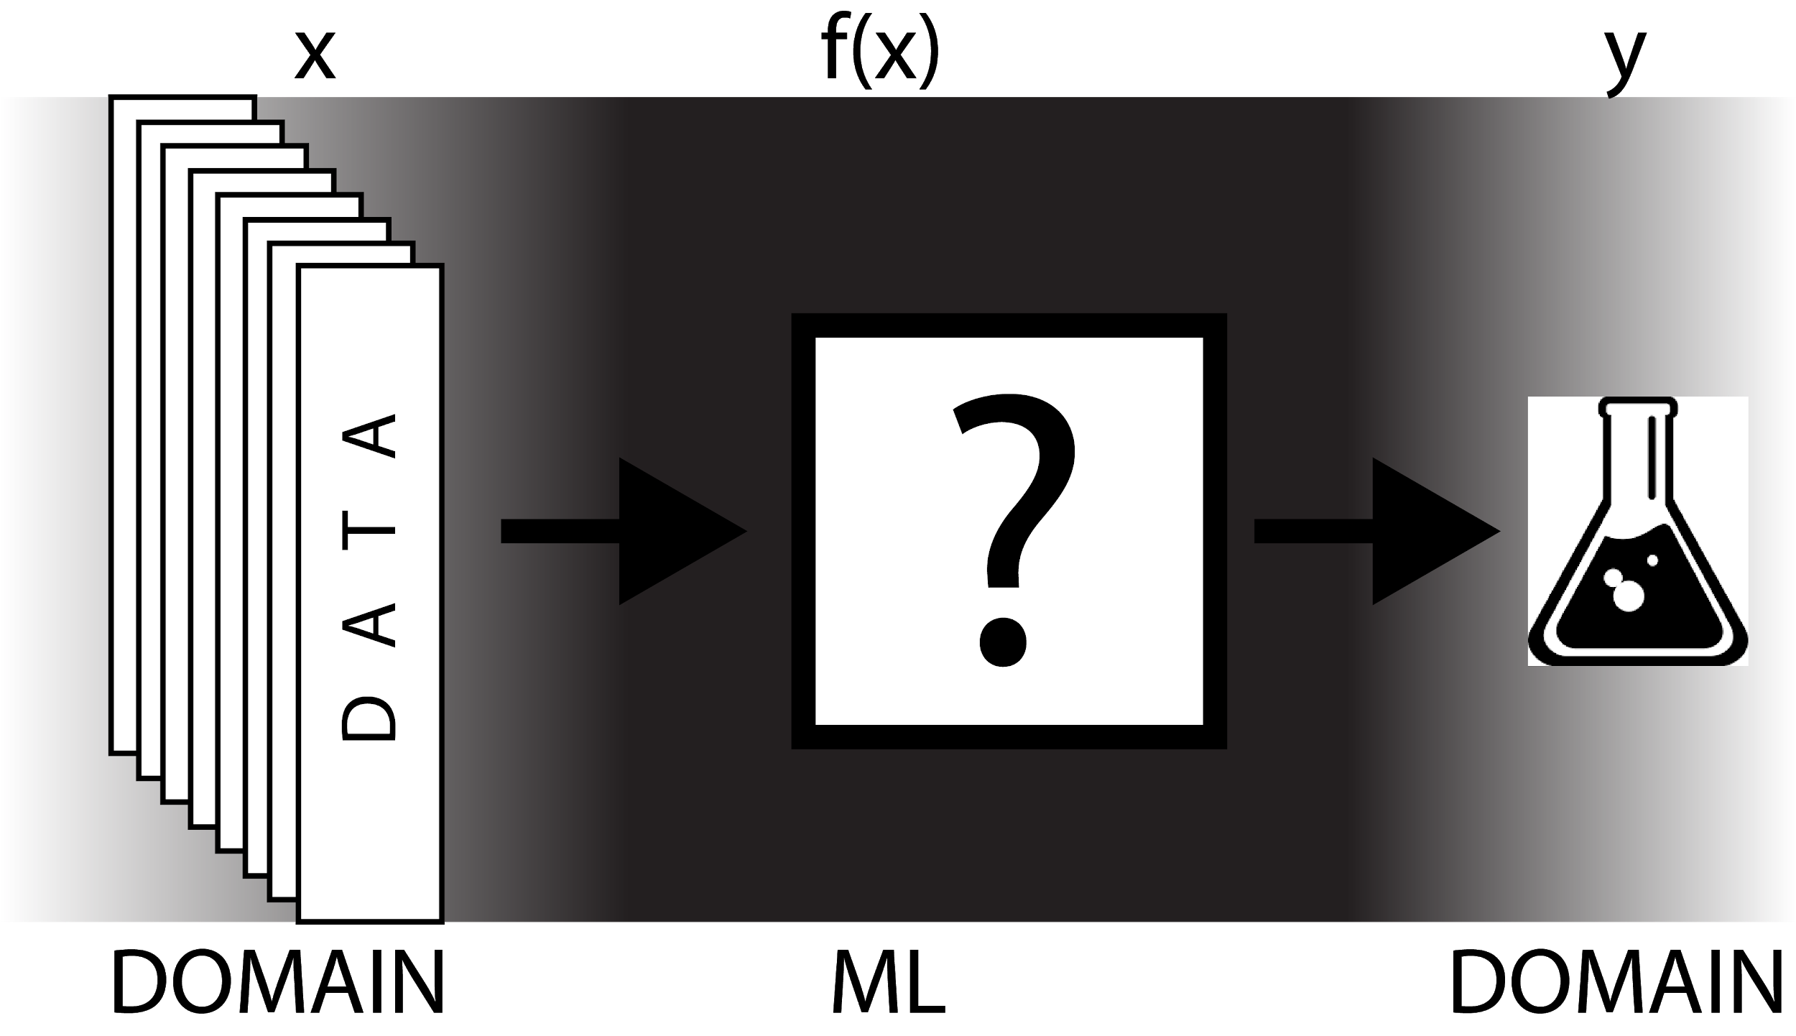

Slide 5
Collaboratory Notebooks
https://colab.research.google.com/
https://biotraining.erc.monash.edu/etherpad/p/deeplearningworkshop
Introduction to Deep Learning with PyTorch - http://bit.ly/2lXxL9Q
Neural networks with PyTorch - http://bit.ly/2kQQX97
Training Neural Networks - http://bit.ly/2mlFwXj
Classifying Fashion-MNIST - http://bit.ly/2krkBBJ
Inference and Validation - http://bit.ly/2m2jwjX
Saving and Loading Models - http://bit.ly/2kQSNqx

Slide 6
Learn how to modify your network for different purposes on calibration of modern neural networks
Zongyuan Ge

Slide 7
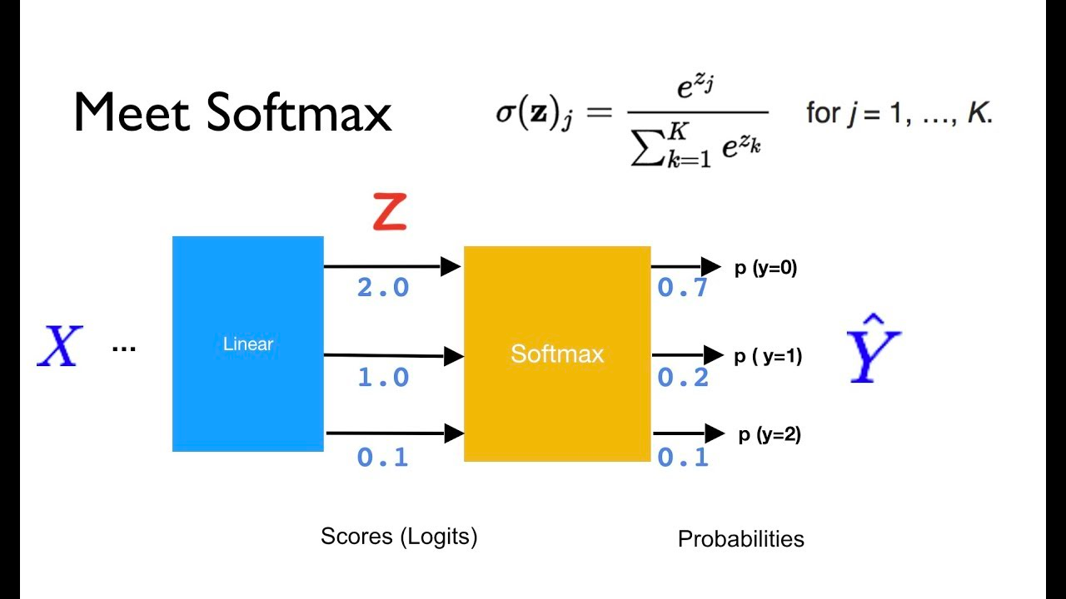
Notation
Using the Softmax to output the class classification result.
We are interested in classification, but confidence is equally important as well.

Slide 8

Make a decision
Camera sensor identifies [Plastic bag] [50% confidence]
Other sensors identify [Pedestrian] [90% confidence]

Slide 9
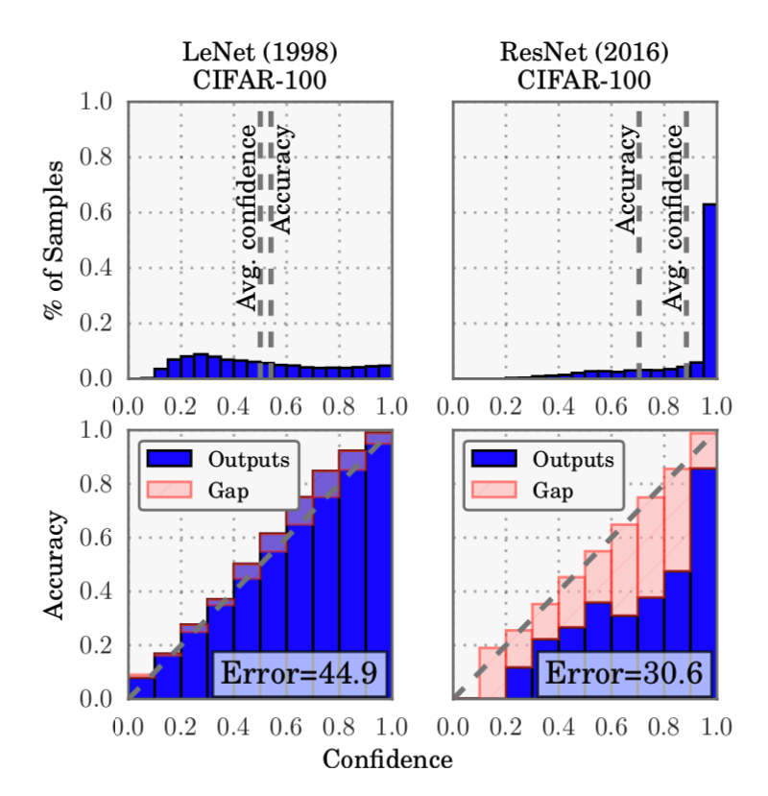
The overconfidence problem

Slide 10
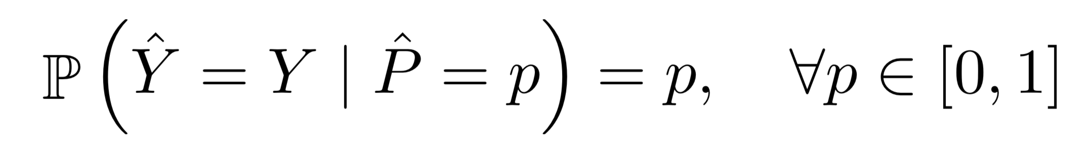
Perfect calibration
Y: Class Label
Y^: Class Prediction
P^: Associate Confidence
p = [0, 1]

Slide 11
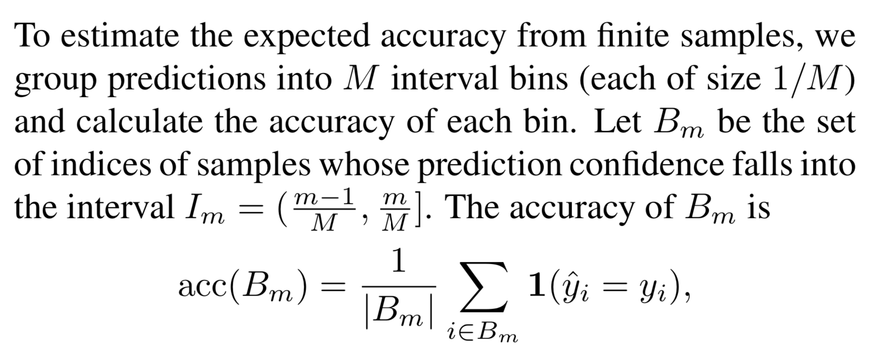

Slide 12
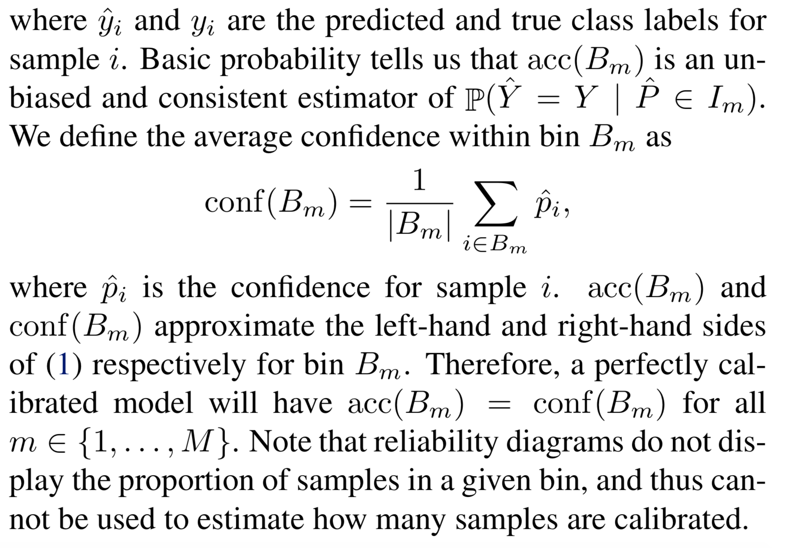

Slide 13
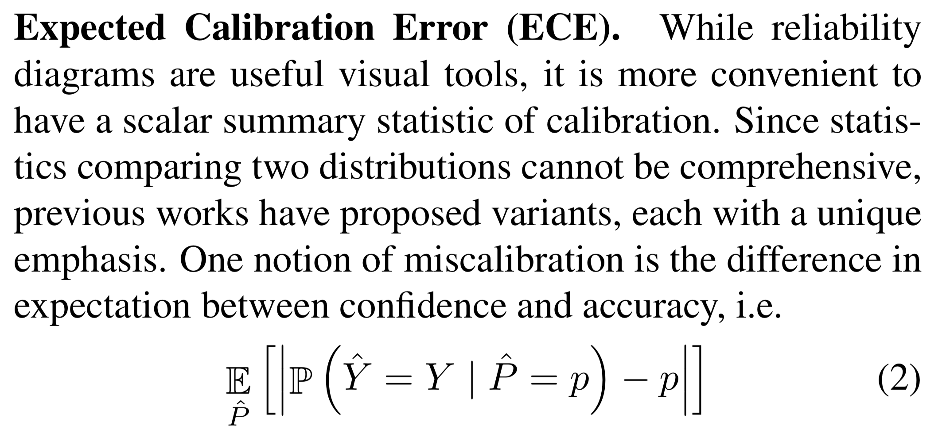

Slide 14
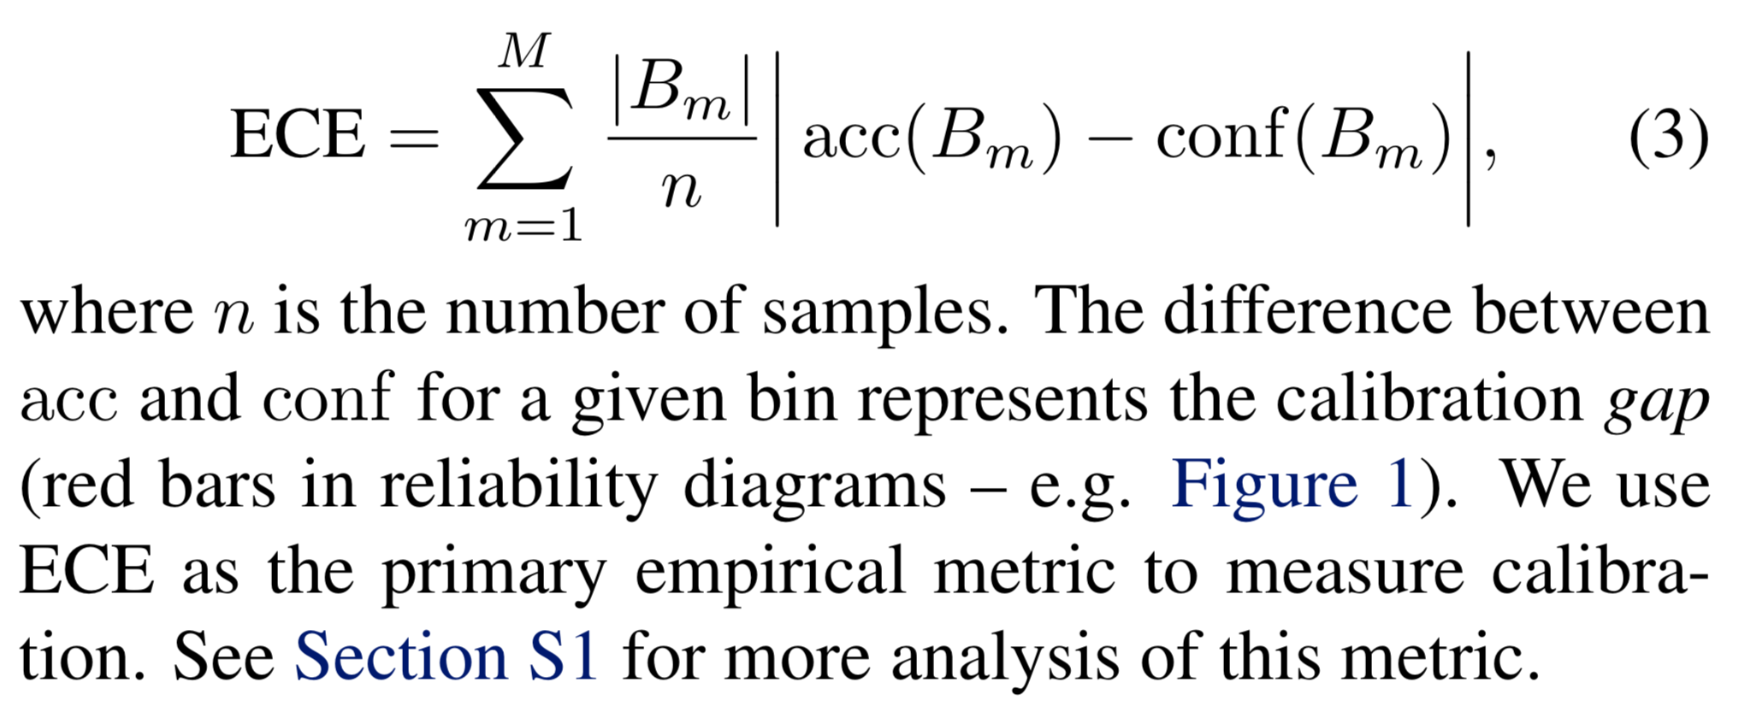

Slide 15
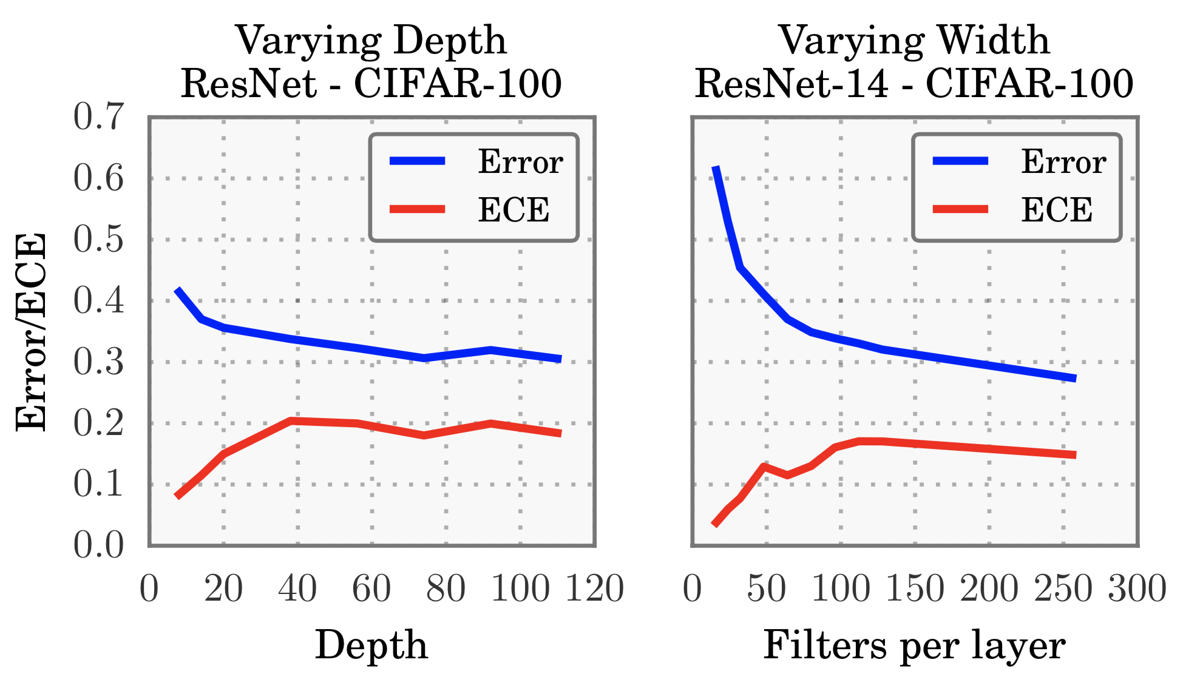

Slide 16
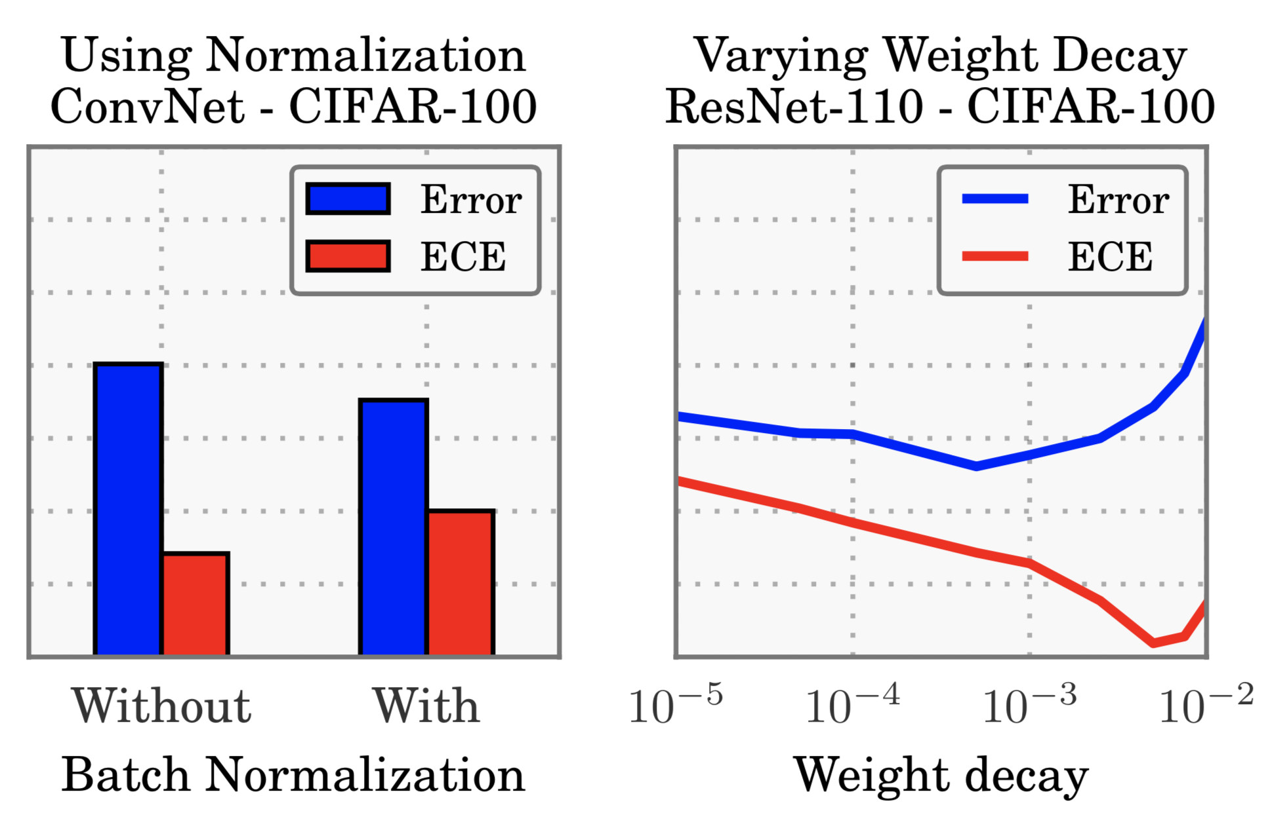

Slide 17
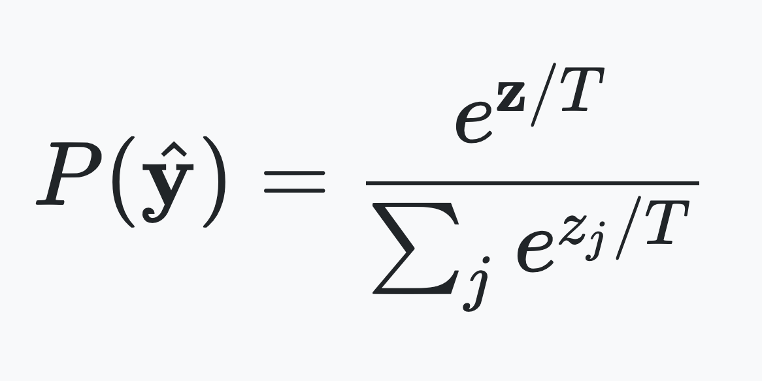
Temperature Scaling
There is a surprisingly simple recipe to fix this problem: Temperature Scaling is a post-processing technique which can almost perfectly restore network calibration. It requires no additional training data, takes a millisecond to perform, and can be implemented in 2 lines of code.

Slide 18
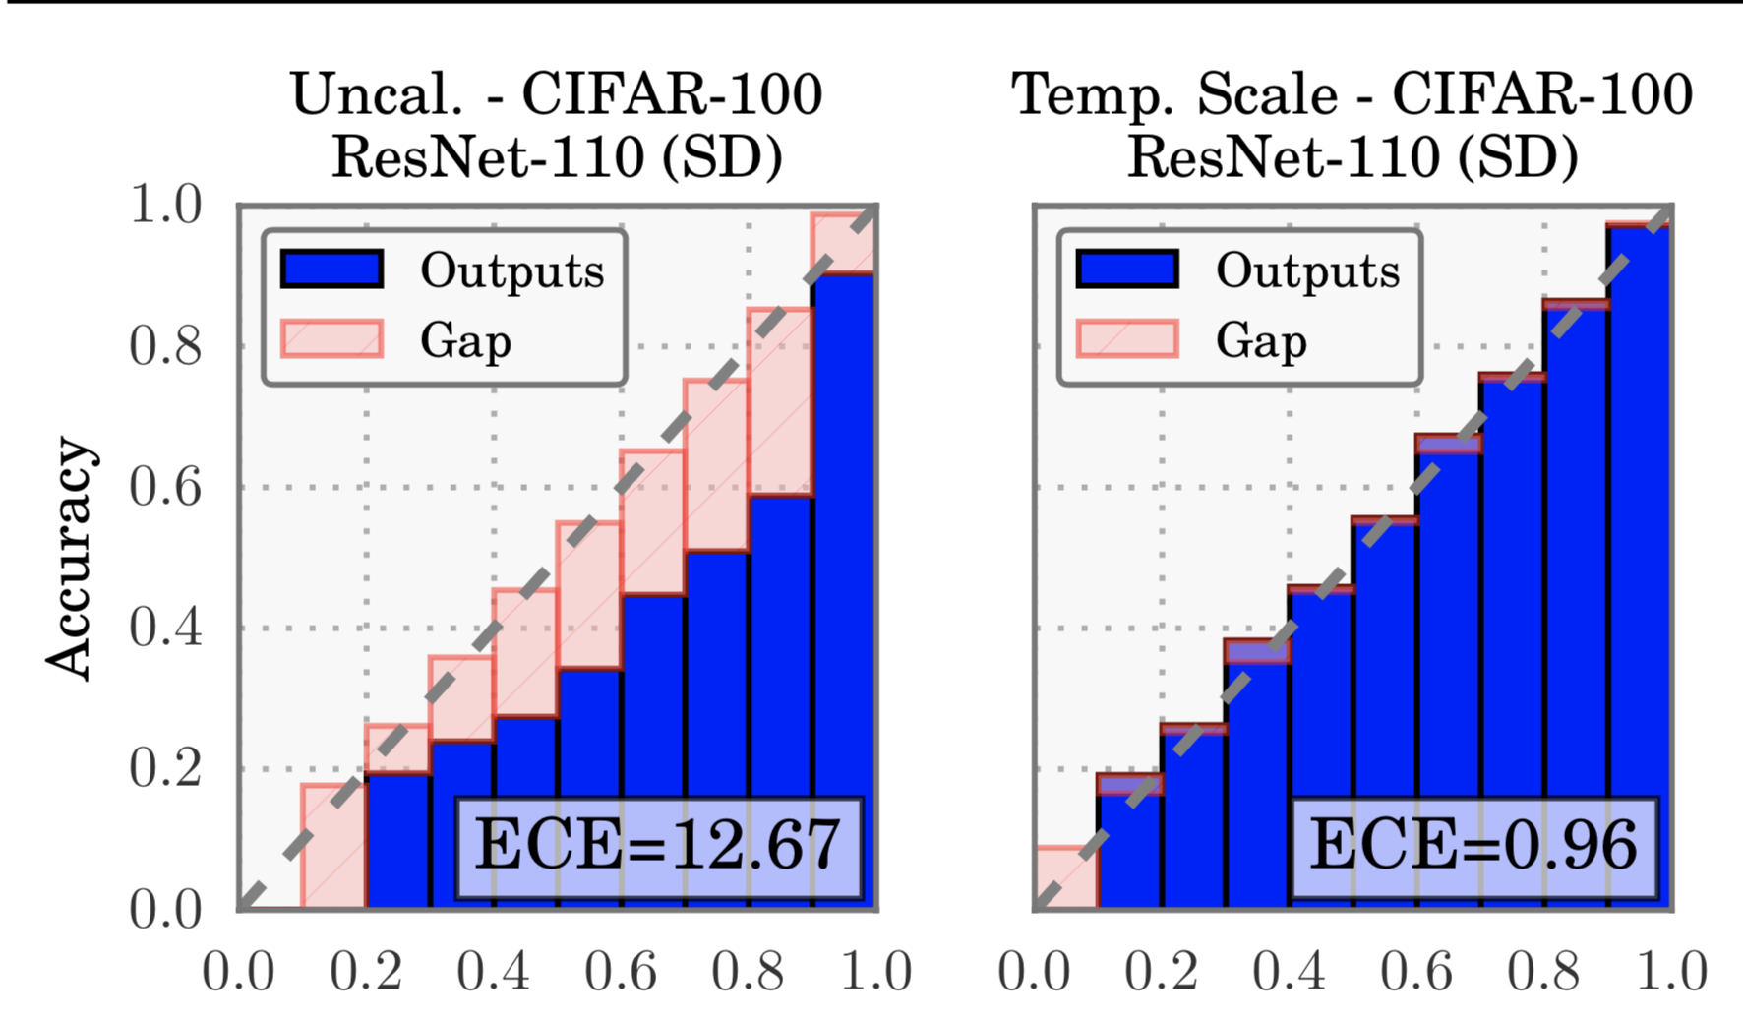

Slide 19
Programming task:
Introduce the code structure (15 mins)
https://github.com/zongyuange/Workshop-repository
Task 1: Build the basic elements for temperature scaling. (60 mins)
1-1: Write “softmax” function in “scaling_utils.py”
1-2: Find the temperature parameter T in “temperature_scaling.py” using optimizer (https://docs.scipy.org/doc/scipy/reference/generated/scipy.optimize.minimize.html)
1-3: Write “predict” function in “temperature_scaling.py”
Task 2: Use TemperatureScaling class to calibrate the model (30 mins)
2-1: Write the code in function “model calibration” from “scaling_diagrams.py”
2-2: Conduct model calibration with learnt temperature
Task 3: Write ECE for model visualization (30 mins)
“ECE” function in “scaling_utils.py”

Slide 20
Working on a cluster
Gin Tan

Slide 21


Job scheduler
All HPC systems have a queuing system that examines your job requirements and finds available hardware, where it is placed in a queue until it is scheduled to run on a compute node.
More will be covered later, but behind the scenes, schedulers are often considered to be like a game of Tetris...

Slide 22
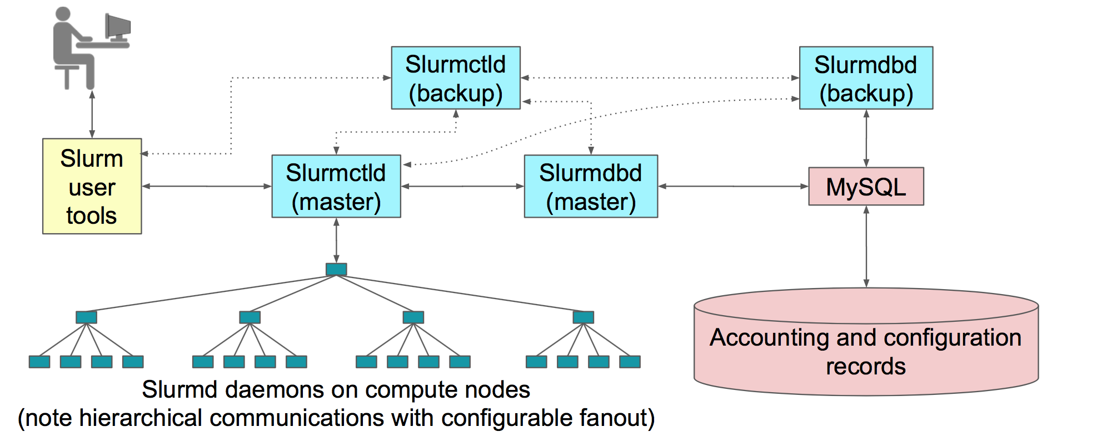
Working on a cluster

Slide 23
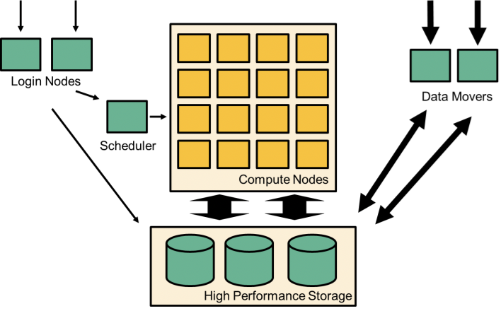
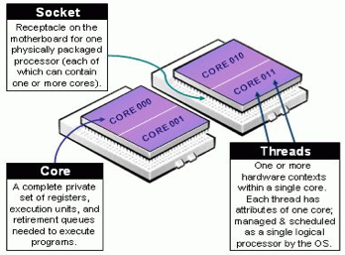
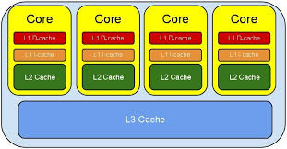
Inside a compute node
Each compute node has one or more CPUs:
Each CPU has multiple cores
Each CPU has memory attached to it
Each node has an external network connection
Nodes are connected together using interconnect
Some systems have accelerators (e.g. GPUs)

Slide 24

MASSIVE M3
Total number of cores: 5,288
Total number of GPU cores: 1,115,648 CUDA cores
Supported GPU: Nvidia Tesla K80, K1, P4, P100, V100
Storage capacity: 2.9 PBytes Lustre parallel file system
Interconnect: 100 Gb/s Ethernet Mellanox Spectrum network
M3 utilises the SLURM scheduler to manage the resources with five partitions/queue available to users, with different configurations to suit a variety of computational requirements.

Slide 25
MASSIVE M3 - continued
All users need to belong to a project, overseen by a CI (Chief Investigator)
All users are given a fairshare of the cluster (a.k.a. account)
All compute nodes run Linux distribution - Centos 7
We use container technology extensively to support software run by other operating systems
Access to the cluster is normally by a command line interface (via ssh)

Slide 26
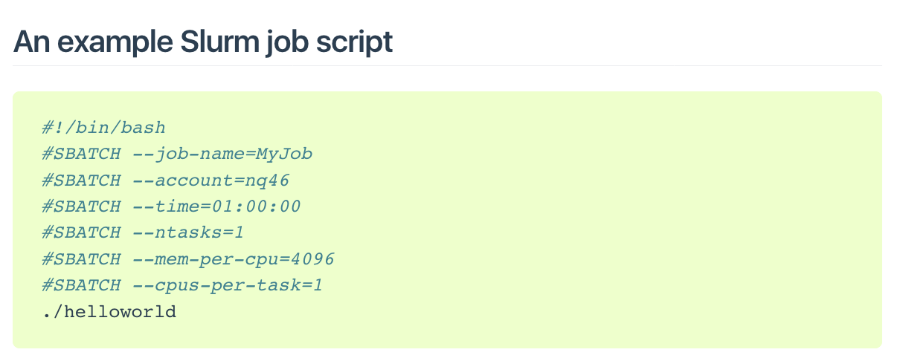
sbatch
sbatch submits a batch script to Slurm.
The batch script may be given to sbatch through a file name on the command line, or if no file name is specified, sbatch will read in a script from standard input.
The batch script may contain options preceded with "#SBATCH" before any executable commands in the script.
sbatch exits immediately after the script is successfully transferred to the Slurm controller and assigned a Slurm job ID.
The batch script is not necessarily granted resources immediately, it may sit in the queue of pending jobs for some time before its required resources become available.

Slide 27
Software modules
To prevent conflicts between software names and versions, applications and libraries are not installed in the standard directory locations.
Modules modify the environment to easily locate software, libraries, documentation, or particular versions of the software
module load pytorch

Slide 28
module command
Command | Description
module avail | Show available modules
module list | List loaded modules
module load modulename | Load a module into the current environment
module rm|unload modulename | Unload a module from the environment
module purge | Unload all loaded modules
module swap module1 module2 | Swap a loaded module with another
module show modulename | Give help for a particular module
module help | Show module specific help

Slide 29
module command - continued
module load tensorflow/2.0.0-beta1
[smichnow@m3-login2 bin]$ python
INFO: Could not find any NVIDIA binaries on this host!
imPython 3.6.8 (default, Jan 14 2019, 11:02:34)
[GCC 8.0.1 20180414 (experimental) [trunk revision 259383]] on linux
Type "help", "copyright", "credits" or "license" for more information.
>>> import tensorflow as ts
>>>
Note. Not all nodes are the same
In the above example, tensorflow was loaded on a login node, which does not have any GPUs
Note the warning message
Try this on your compute node and see if you get a different output
Your desktop machine contains a GPU card

Slide 30
Task 1 - write a sbatch script
ssh trainingxx@m3.massive.org.au
use the given password, if you haven’t had one, please ask for one.
once you are in, git clone https://github.com/gintan/deeplearningworkshop.git
write a sbatch script to submit the code to the scheduler
use module load to load the pytorch environment

Slide 31
Task 1 - example of sbatch script
#!/bin/bash
#SBATCH --job-name=pytorch
#SBATCH --account=training
#SBATCH --time=01:00:00
#SBATCH --mem=32G
#SBATCH --ntasks=1
#SBATCH --cpus-per-task=1
#SBATCH --gres=gpu:P4:1
module load pytorch
python3 finetune_torchvision.py
Cool tips:
#SBATCH - do not leave space between the “#” key and “SBATCH”, once you leave a space, SLURM will read it as comment
Also, if you add any command after “#!/bin/bash”, the “#SBATCH” will not be read.

Slide 32
Useful commands to check your job
scontrol show job {jobID}
When you obtain your job ID, you can check the information about your job
squeue
view information about jobs located in the Slurm scheduling queue
squeue -u {username}
view information about jobs located in the queue for one or more users
scancel {jobID}
Used to signal jobs or job steps that are under the control of Slurm

Slide 33
Checking the job status - use scontrol
Although we covered requesting resources from the scheduler earlier, how do we know how much and what type of resources we will need in the first place?
Answer: we don’t. Not until we’ve tried it ourselves at least once. We’ll need to benchmark our job and experiment with it before we know how much it needs in the way of resources.
sacct -u {userID}
sacct -j {jobID} -l
Hostname - Where did your job run?
MaxRSS - What was the maximum amount of memory used?
Elapsed - How long did the job take?
State - What is the job currently doing/what happened to it?
MaxDiskRead - Amount of data read from disk.
MaxDiskWrite - Amount of data written to disk.

Slide 34
Task 2 - monitoring the gpu performance
modify your script so you can monitor the performance of the GPU
nvidia-smi is the command that I use
if you know any way to monitor the GPU performance in your code, please do let me know
The command:
nvidia-smi --help-query-gpu
For more information:
https://nvidia.custhelp.com/app/answers/detail/a_id/3751/~/useful-nvidia-smi-queries

Slide 35
Task 2 - example of sbatch script
#!/bin/bash
#SBATCH --job-name=pytorch
#SBATCH --account=training
#SBATCH --time=01:00:00
#SBATCH --mem=32G
#SBATCH --ntasks=1
#SBATCH --cpus-per-task=1
#SBATCH --gres=gpu:P4:1
# Start the nvidia-smi command
nvidia-smi dmon -s pucvt -o DT -d 10 -f nvidia-smi.dmon$1.$(date "+%Y.%m.%d-%H.%M.%S").csv &
# Get its PID
PID=$!
module load pytorch
python3 finetune_torchvision.py
kill $PID

Slide 36

Last but not least
Thanks to Monash Data Fluency Platform
Data Fluency Slack Channel: datafluency.slack.com
Bioinformatic Drop-in (every Friday)
MASSIVE M3: https://www.massive.org.au
M3 User Documentation: https://docs.massive.org.au
Reach out: info@massive.org.au
Etherpad: https://biotraining.erc.monash.edu/etherpad/p/deeplearningworkshop
Please leave feedback!

